Slide 1

INDUSTRY 4.0 M.DRUMARE

Slide 2
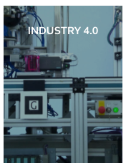
ON FLIPBOARD
http://flip.it/fr-SyJ

Slide 3
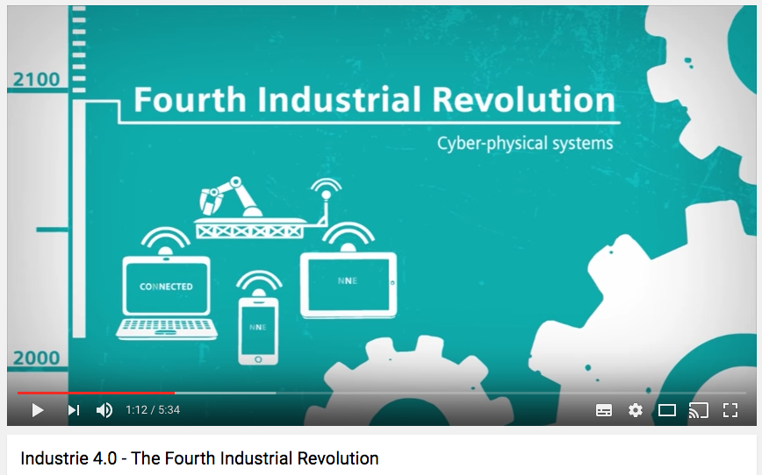
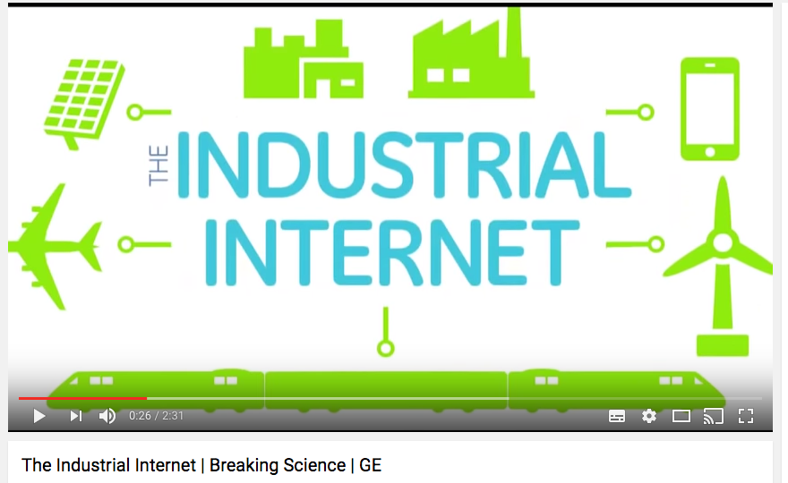
Made in Germany (Siemens)
Made in USA (General Electric)

Slide 4
WHAT ?

Slide 5
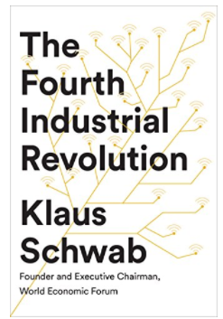
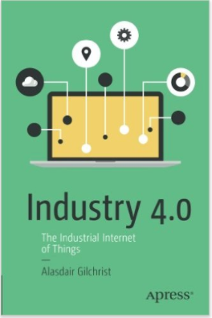
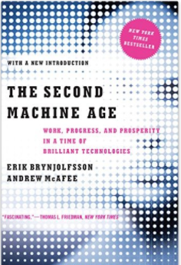
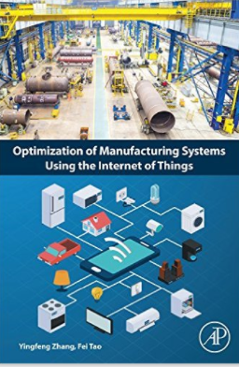
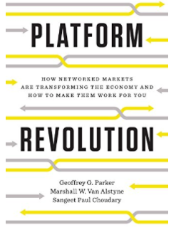
FEW WORDS, ONE REVOLUTION
Fourth Industrial Revolution (World Economic Forum Davos)
IIOT-Industrial Internet (USA)
Industry 4.0 (Germany / Japan/ China )
Smart Factory (Automotive and Aerospacial Industries)

Slide 6
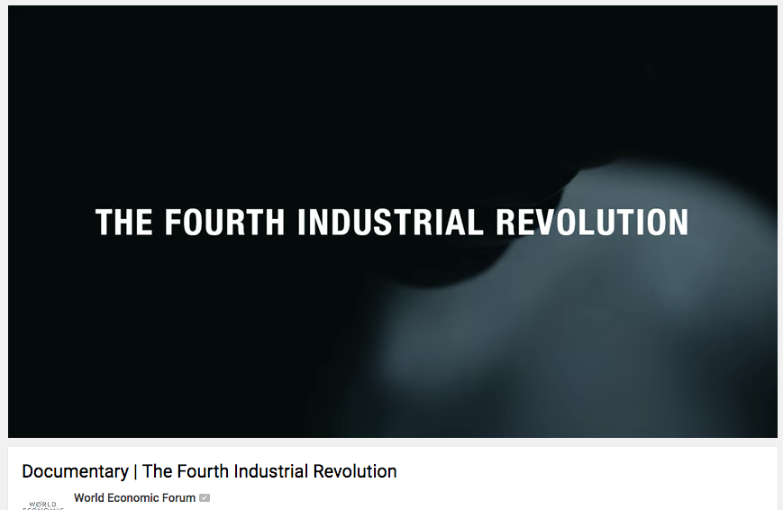
THE FOURTH INDUSTRIAL REVOLUTION
Challenges : Human, Environmental, Societal, Economics.
Tackle difficult problems : pollution, energy demand, pressure of urbanization.
Impact Physical, digital and biological worlds.
New ways of using technology to change behaviour and our systems of production and consumption.
Supporting the regeneration and preservation of natural environments.

Slide 7
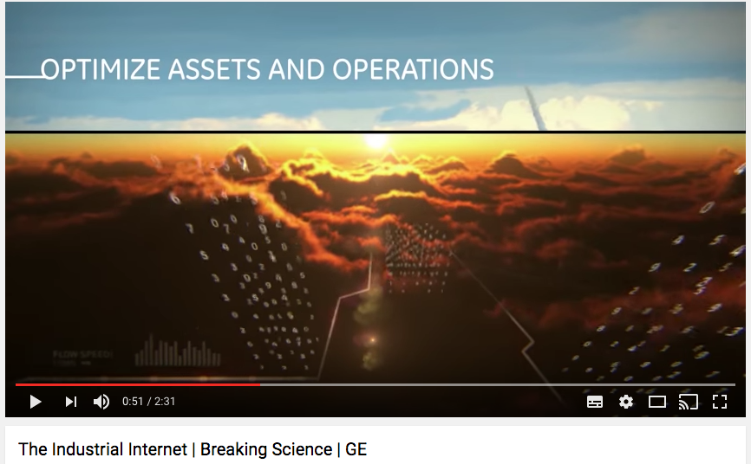
THE INDUSTRIAL INTERNET
Challenges : IoT use by the industry, The emergence of Software Analytics companies.
The Industrial Internet connects smart machines to an interoperable platform that instantly transmits realtime data through strategically designed software applications.
Improving efficiency and preventing damage or unplanned breakdowns.
Improving the efficiency of hospitals, wind farms, airplanes, freight trains, power plants and more.

Slide 8
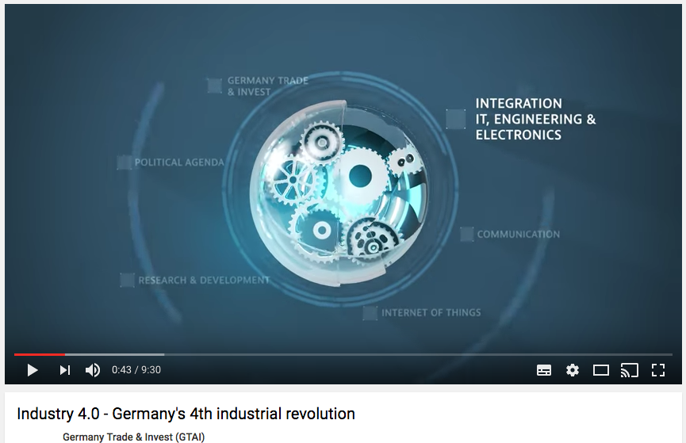

INDUSTRY 4.0
Challenges : German Leardership.
Industrial production is disrupted by digitisation.
Germany has set itself the goal of being an integrated industry lead market and provider by 2020.
Leading companies: BASF, Bosch, Daimler, Deutsche Telecom, Klöckner&Co, Trumpf, Siemens.
The Economist : Does Deutschland do digital?
https://goo.gl/EgYzQ9

Slide 9
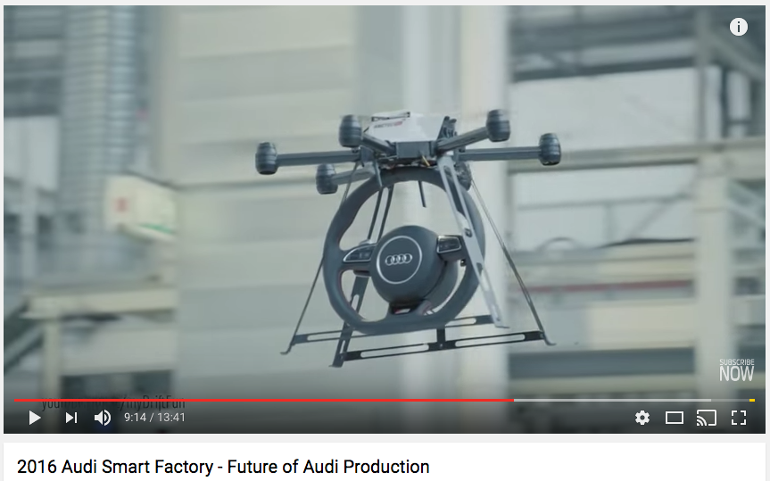
SMART FACTORY
Challenges: Personalization of each product, higher productivity, implement new processes of production.
From the assembly line to the modular assembly .
Integration of smart robots, virtual reality glasses, 3D Printing, drones in the assembly process.
Leaders: Audi, Mercedes, BMW, Toyota, Boeing, Airbus.

Slide 10
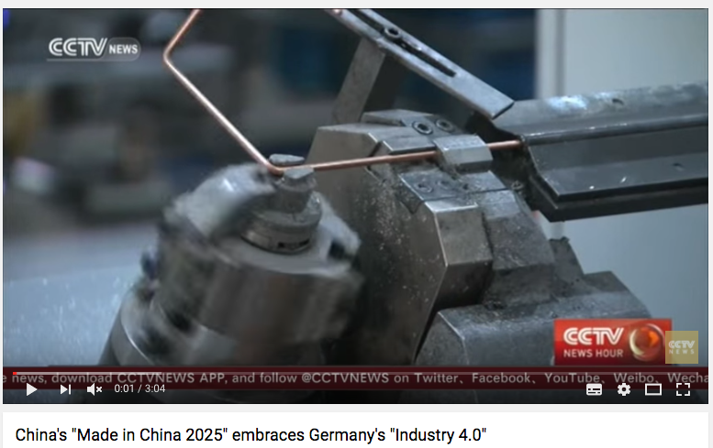
MADE IN CHINA 2025
Manufacturing be innovation-driven, emphasize quality over quantity, achieve green development, optimize the structure of Chinese industry, and nurture human talent.
Raising domestic content of core components and materials to 40% by 2020 and 70% by 2025.
Although there is a significant role for the state in providing an overall framework, utilizing financial and fiscal tools, and supporting the creation of manufacturing innovation centers (15 by 2020 and 40 by 2025).
The plan highlights 10 priority sectors: 1) New advanced information technology; 2) Automated machine tools & robotics; 3) Aerospace and aeronautical equipment; 4) Maritime equipment and high-tech shipping; 5) Modern rail transport equipment; 6) New-energy vehicles and equipment; 7) Power equipment; 8) Agricultural equipment; 9) New materials; and 10) Biopharma and advanced medical products.

Slide 11
WHAT MADE THIS REVOLUTION 4.0 POSSIBLE?
Emerging technology breakthroughs covering wide-ranging fields such as :
Economy of Mass Customization
Artificial intelligence (AI)
Advanced Robotics.
The internet of things, sensors, Big Data.
Autonomous vehicles and drones.
3D printing.
Nanotechnology.
Augmented Reality.

Slide 12
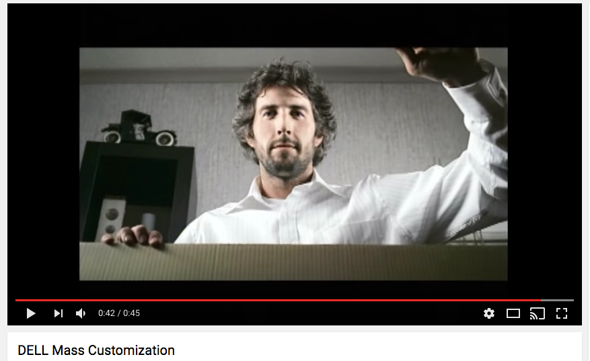
ECONOMY OF MASS CUSTOMIZATION
Mass customisation is a production process that combines elements of mass production with those of bespoke tailoring.
Products are adapted to meet a customer's individual needs, so no two items are the same.

Slide 13
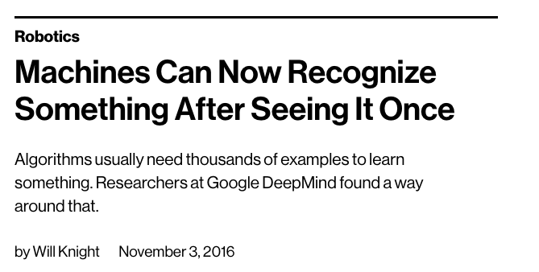
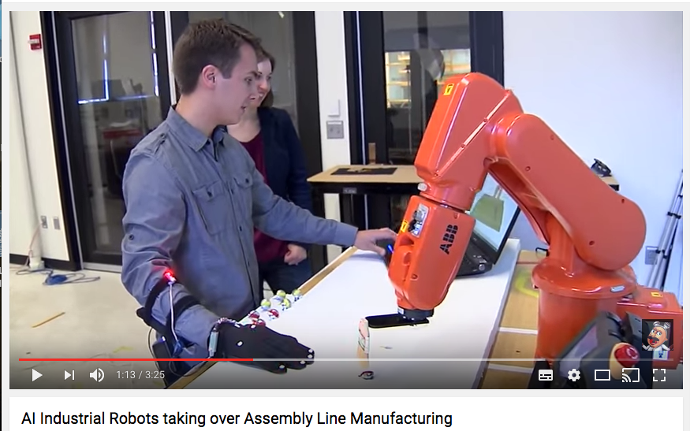
AI
Artificial Intelligence is the science concerned with the creation of machine intelligence which is able to perform tasks heretofore only performed by people.
Design the robots with artificial intelligence to enable them to learn from experience. The robots will be more responsive to human behavior.
The more robots can sense the humans around them and make adjustments, the safer and more effective the robots will be on the assembly line.

Slide 14
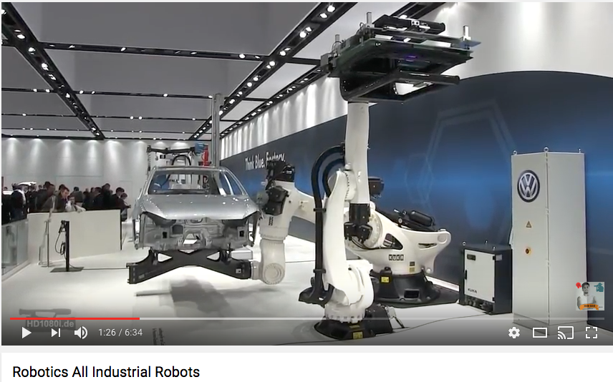
ADVANCED ROBOTICS
The term "advanced robotics" first can into use in the 1980s.
It is used to define any sensor-based robots that attempt to mimic human intelligence.
Robots are used in a variety of fields ranging from manufacturing, nuclear, construction, space and underwater exploration, and health care.

Slide 15
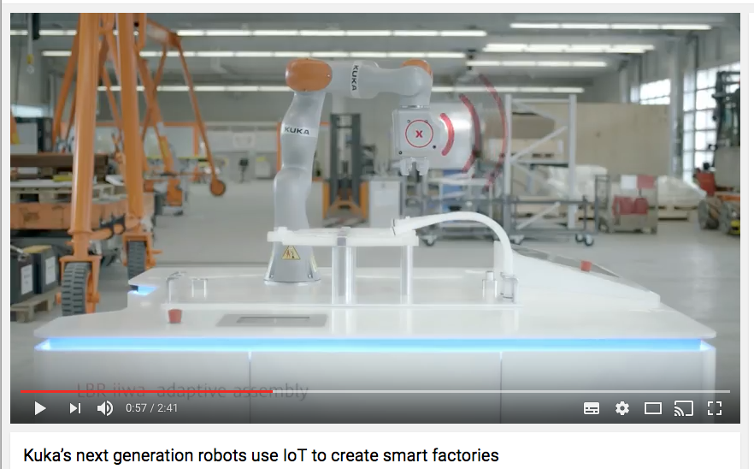
IoT, SENSORS & CLOUD COMPUTING
The Internet of Things (IoT) is an evolution of mobile, home, industrial and embedded devices that are connected to the internet, integrating computing capabilities and using data analytics to extract valuable information.
On the assembly line, the robots and the workers communicate via the Cloud.
The data sent to the Cloud allow visual reporting and the connection of the factory to the top management.

Slide 16
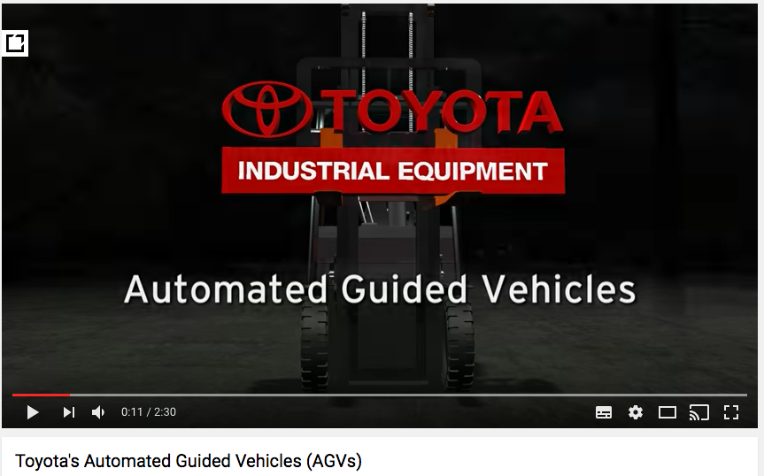
AUTONOMOUS VEHICLES
An automated guided vehicle is a mobile robot that follows markers or wires in the floor, or uses vision, magnets, or lasers for navigation.
They are most often used in industrial applications to move materials around a manufacturing facility or warehouse.

Slide 17
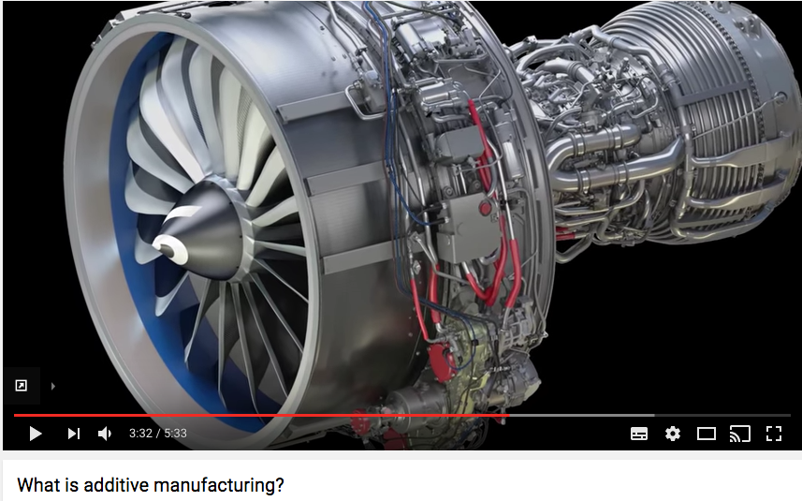
3D PRINTING
3D Printing and Additive Manufacturing (AM) refers to a process by which digital 3D design data is used to build up a component layers by depositing material.
Fast prototyping.
Reduce the cost of production.
Complex geometries.
Part consolidation.
Enhanced performance (weight, flexibility, strenght, thermal management, etc).
Increased supply chain efficiency, reduce inventory.

Slide 18
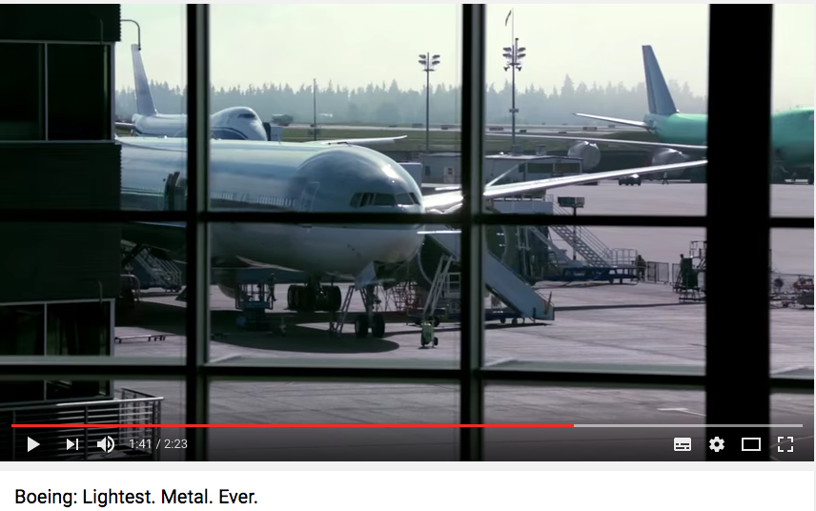
NANOTECHNOLOGY
Nanotechnology is the manipulation of matter with at least one dimension sized from 1 to 100 nanometers (10⁻⁹ meter).
Vast range of applications such as in nanomanufacturing, nanomedecine, nanoelectronics, biomaterials energy production and consumer products.

Slide 19
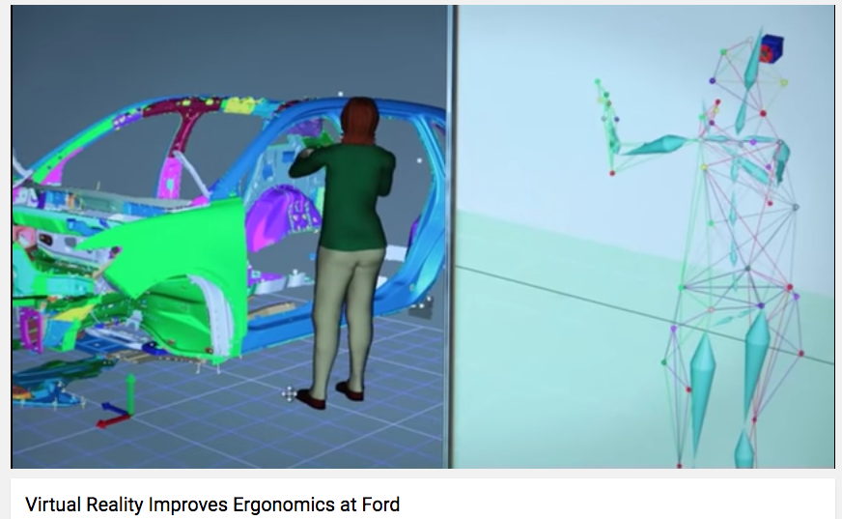
AUGMENTED REALITY
VR has been defined as « a realistic and immersive simulation of a 3 dimensional environment, created using interactive software and hardware, experienced or controlled by movement of the body.
Companies are now planning their production and assembly processes out in full in a virtual world (Siemens & Boeing)
Companies use AR to improve the working condition on the assembly line (Ford)

Slide 20
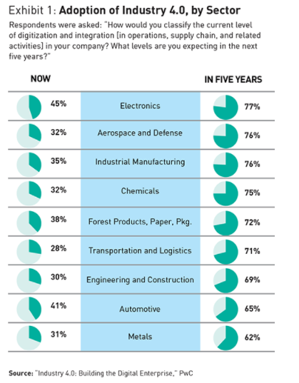
ADOPTION OF INDUSTRY 4.0
In 2015, PwC surveyed :
more than 2,000 companies.
26 countries.
Sectors: Aerospace and defense; automotive; chemicals; electronics; engineering and construction; forest products, paper, and packaging; industrial manufacturing; metals; and transportation and logistics.
One-third of the respondents said their company had already achieved advanced levels of integration and digitization.
72 % expected to reach that point by 2020.

Slide 21
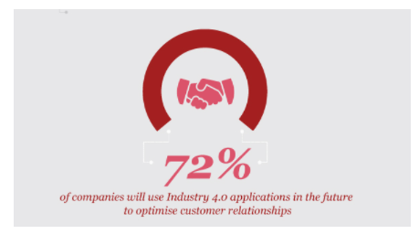
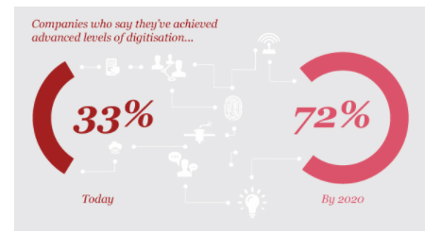
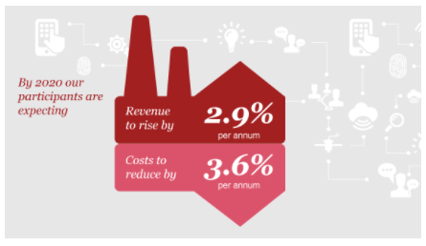
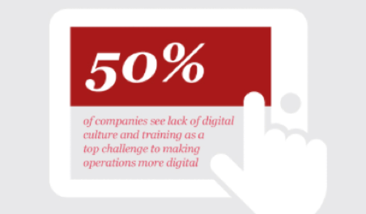
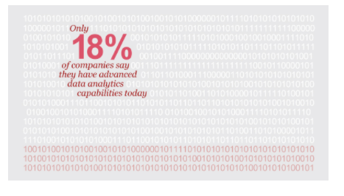
ADOPTION OF INDUSTRY 4.0
EXPECTATIONS
CHALLENGES
PwC, 2016

Slide 22
WHY COMPANIES ADOPT INDUSTRY 4.0?
Revenue Gains: by offering new digital features and products and new digital services to customers.
Maket Share Gains : by offering more personalized products and customized solutions with the availability of real-time data.
Cost Reductions : by using predictive analytics that allow real-time quality control and maintenance.
Higher Performance : by improving the User Experience in operational systems. Employees tend to be happier and more productive. Lowers costs for training, support, staff turnover and raises operations speed.
Global Competition : « The first half of the battle to master the digital world was lost (defeated by USA), according to Timotheus Höttges, the boss of Deutsche Telekom. “The question now is: how do we (Germany) win the second half?”

Slide 23
HOW ?

Slide 24
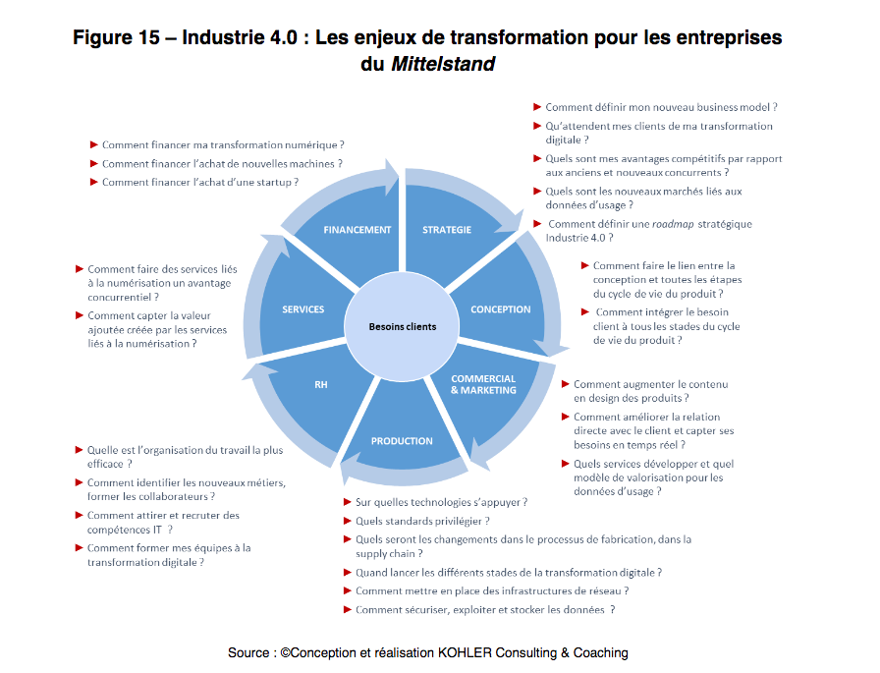
MULTIPLE CHALLENGES FOR THE ORGANIZATION

Slide 25
HOW TO BECOME AN IIoT ORGANIZATION
Define their IIoT strategy and goals: opportunities, priorization, roadmap.
Make Partnership and alliances : No single enterprise will possess the full range of ressources and skills required to address the challenges associated with IIoT.
Implement an IIoT Platform and create pools of expertise named Center of Excellence (CoE).
Adopt the Digital Performance Management.

Slide 26
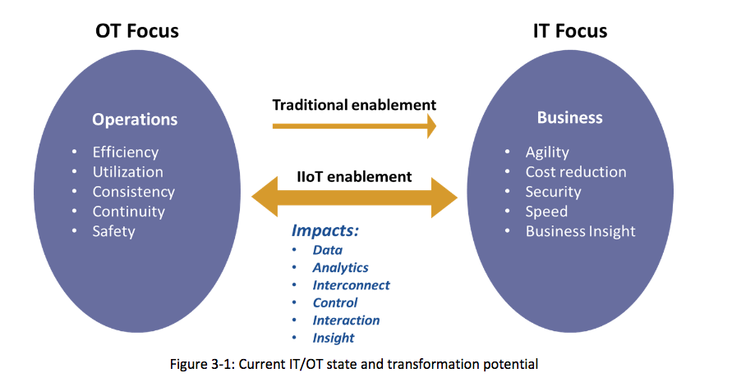
INTEGRATE OT AND IT
Integration of the Operational Technology and Information Technology.
The central strategic challenge for companies will be to combine and gather insight from data across all aspects of the enterprise to make informed business and operational decisions, whether in real-time or predictively.

Slide 27





INTEGRATE OT AND IT : AIRCRAFT COMPANY
DATA
DATA
IoT Software Platform
IT DEPARTMENT
Business
-Customer Experience
-Reservations
-Inventory
-Planning
-Predictive Maintenance
Reduce the Costs
Optimize the Maintenance
OT DEPARTMENT
Operational
-Grounbased Operations
-Inflight Operations
DATA
DATA
Enhance the safety
New Customer Value

Slide 28
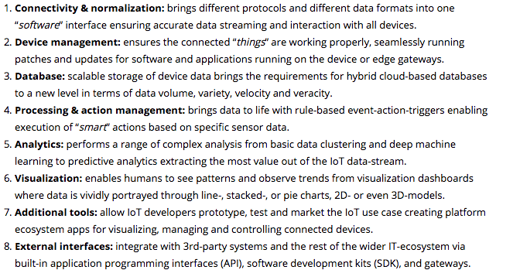
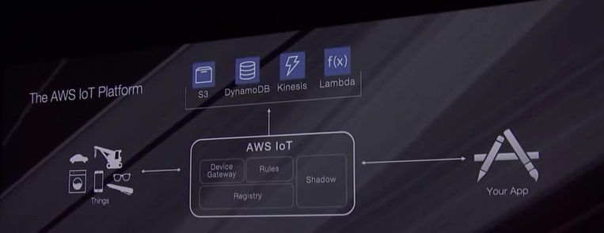
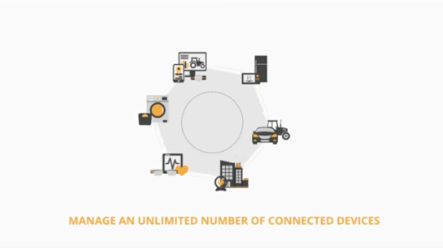
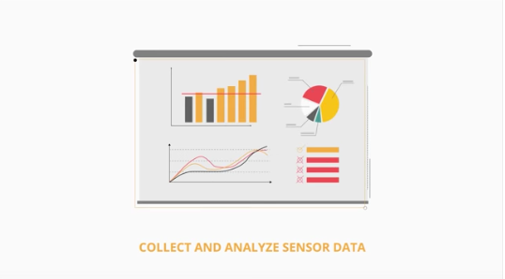
IMPLEMENT IIoT PLATFORM
The 8 components of an IIoT Platform

Slide 29
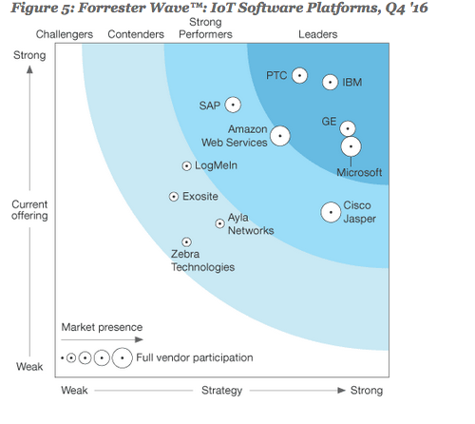
IMPLEMENT IIoT PLATFORM
By 2019, IoT Platform market will reach $1billon.
Leaders:
-IBM : The Watson Iot Platform
-PTC : Thingworx Platform
-GE: Predix Platform
-Microsoft : Azure IoT Suite
Strong Performers :
-Amazon Web Services
-SAP
-Cisco Jasper
Open-Source IoT Platform (Kaa Project)

Slide 30
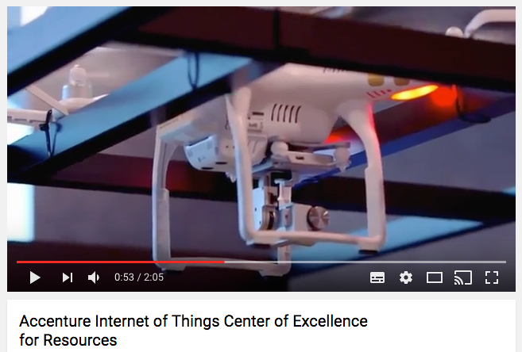
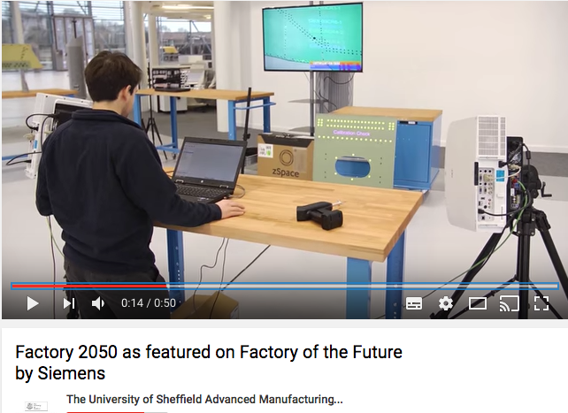
ESTABLISH IIoT CENTER OF EXCELLENCE (CoE)
Need of new pools of expertises: sensors, robotics, 3D Printing, etc…
3 ways to increase knowledge and best practices about IIoT.
External: augment internal skills with IIoT partner ecosystems formed by large industrial players, universities, governments, consutancy.
Internal : establish company own CoE to leverage expertise across multiple applications and business units.
Hybrid: both external and internal.

Slide 31
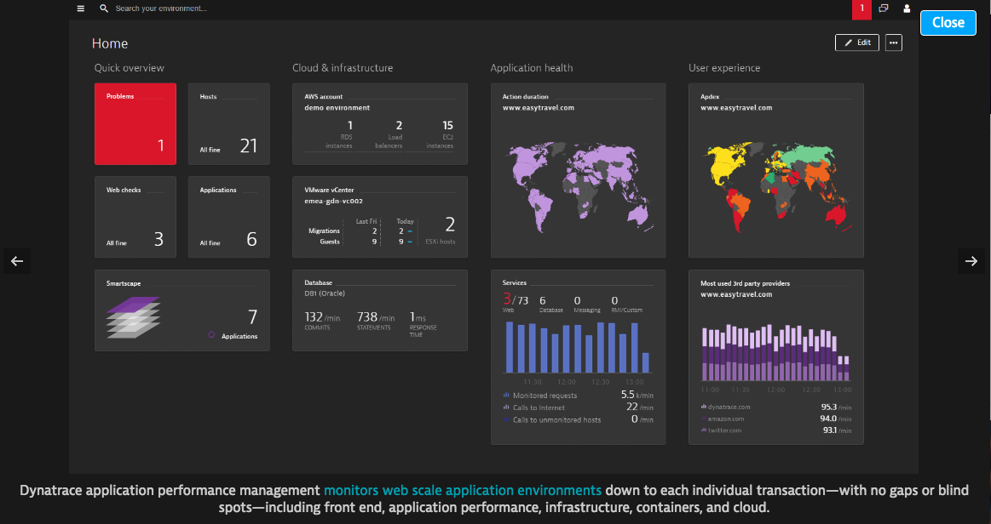
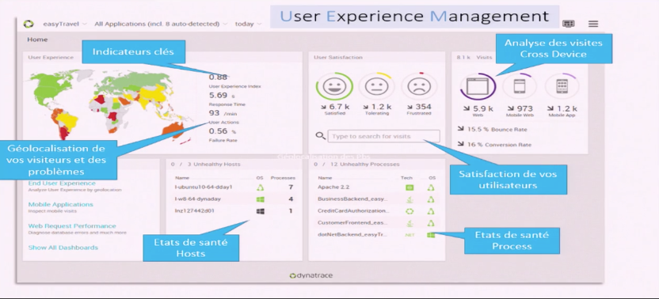
DIGITAL PERFORMANCE MANAGEMENT
Perceived customer experience (click)
Delivered customer experience (eco-system behind the click)
Most businesses aren’t capable of merging both views.Reacting either to customer feedback or to IT health systems information.
Challenge of DPM: manage the availability and performance of software applications and the impact on user experience. (Dynatrace)

Slide 32

SIEMENS : NEW DIGITAL MANUFACTURER
New manufacturing Processes...
« Today, we built manufacturing automation lines and design processes before a manufacturing plant has been built. »
« We copy a real-time manufacturing process into the virtual world to optimize engeneering, processing quality…and then we copy it back into the real word of manufacturing. With Boeing, we simulate the whole development and engeneering process for new airplanes. And then we do simulations that test whether the airplane can fly or not. »
« The production process is being changed. It’s machines talking to machines in a self-optimizing and engineering process. Using this approach, we have attained a production quality rate of 99.9998%. »
« Industry 4.0 basically takes the cost of scale close to zero. No matter what lot size you need, the unit cost is about the same. »
« We use a lot of 3D print already. We print small volume prototypes. Speeding up innovation. »
Siemen CEO, Joe Kaeser, february 2016

Slide 33
SIEMENS : NEW DIGITAL MANUFACTURER
New HR, data and business strategies.
« Siemens employs 17500 software engineers. These people develop software inside products as well as build applications and data analytics tools. »
« Our flagship product, the 8000H has thousands of sensors. At every moment, that sensors delivers data to software stored in the cloud. There’s a two step process : collecting data and making use of it. »
« The information you get from data can shorten the value chain, you can make your products faster, more cost-effeciency, with more flexibility. »
« Our perspective is that we now sell solutions, applications, and comprehensive systems as opposed to just selling the product. We sell value instead of selling functionnality. »
« If you shorten the value chain by cutting out links that means fewer resources will be needeed. People will be still in the factory, but they will doing different work than they used to…. There is going to be regulatory and societal catalysts»
Siemen CEO, Joe Kaeser, february 2016
Siemens CEO Joe Kaeser on the Next Industrial Revolution
http://flip.it/ja5Xi2

Slide 34
IMPACTS ?

Slide 35
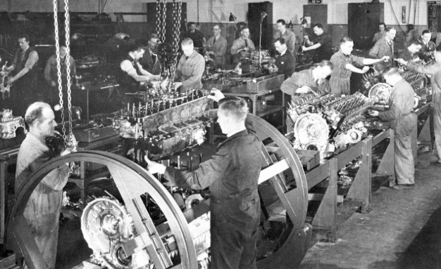
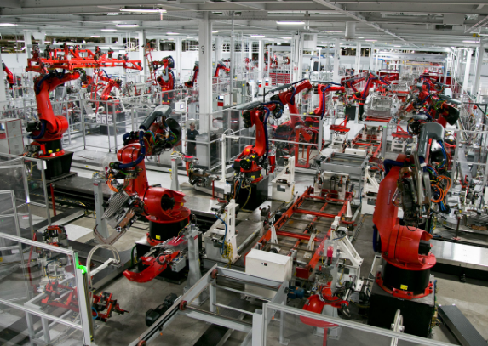
IMPACT ON HUMAN LABOR : LESS JOBS
In its book « the fourth industrial revolution », Schwab compares Detroit in 1990 with Silicon Valley in 2014.
In 1990 the three biggest companies in Detroit had a market capitalisation of $36bn (£25bn), revenues of $250bn and 1.2 million employees.
In 2014, the three biggest companies in Silicon Valley had a considerably higher market capitalisation ($1.09tn) generated roughly the same revenues ($247bn) but with about 10 times fewer employees (137,000).

Slide 36
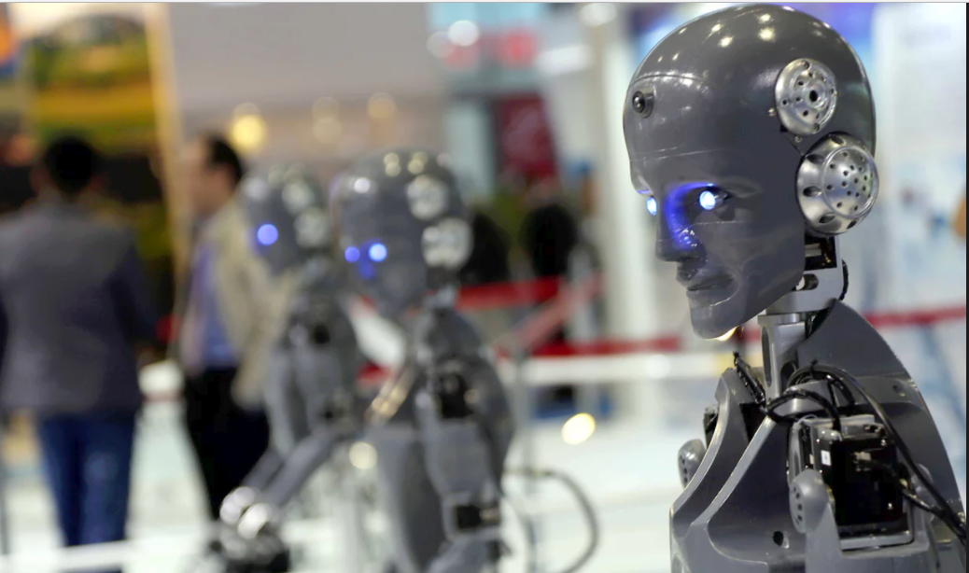
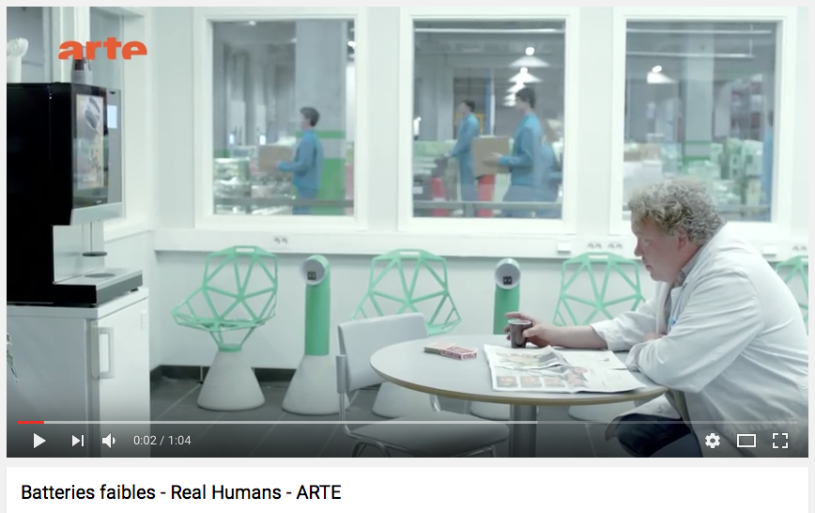
IMPACT ON HUMAN LABOR : INEQUALITY
Smart machines will soon be able to replace all sorts of workers, from accountants to delivery drivers, etc.
47% of US jobs are at risk from automation.
The benefits of the coming change will be concentrated among a relatively small elite, thus exacerbating the current trend towards greater levels of inequality.
Polarisation of the labour force as low-skill jobs continue to be automated and this trend increasingly spreads to middle class jobs.”

Slide 37
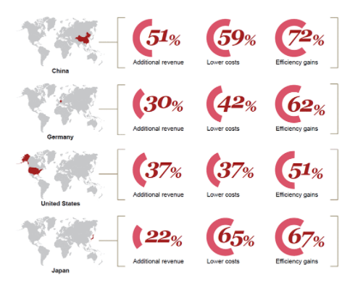
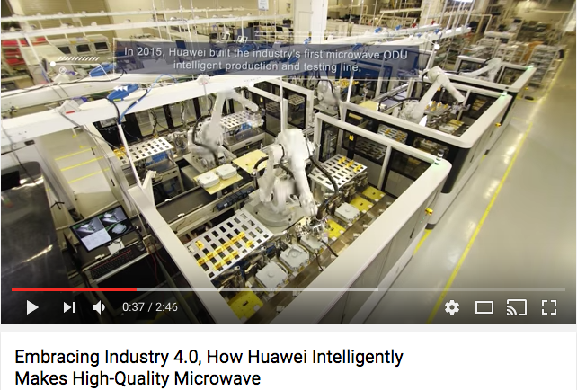
IMPACT ON GLOBALIZATION : WINNING CHINA!
« Japan’s ahead, but Germany, the US and China –and indeed, all the countries expect to make significant progress looking ahead to 2020.
China may arguably have the most to gain from embracing digital technologies. »
Dr. Reinhard Geissbauer Partner, Strategy&, Part of the PwC Network

Slide 38
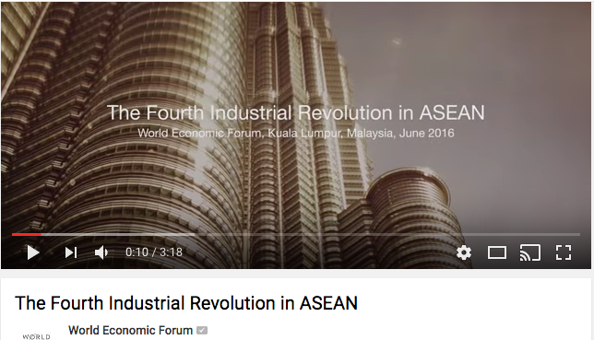
IMPACT ON GLOBALIZATION : WINNING ASIA ?
It is companies in the Asia Pacific region that are making the strongest running. They report making significant digital investments and they have already moved further forward in terms of current digitisation and integration.
40% of the companies in Asia Pacific Region assess they are at an advanced level.
Vs 32% of companies in the Americas.
Vs 28% of EMEA companies.
Challenge: face the talent shortages. Redesign the regional talent value chain will be one major step for ensuring that people are able to live up to their full potential and for positioning the ASEAN economy to thrive.

Slide 39
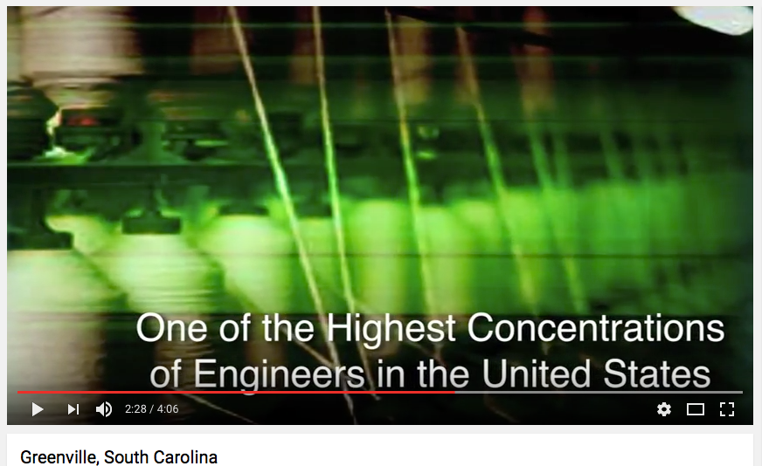
IMPACT ON LOCAL : GREENVILLE IS BOOMING!
Greenville was the heart of the state’s textile industry.
Beginning in the 1970s, facing competition from lower-cost manufacturing regions like Mexico and Southeast Asia, these companies began to struggle.
But Greenville has remained focused on manufacturing. BMW, ABB, Michelin, Bosch, and General Electric’s power division.
As these local factories have adopted increasingly computerized and automated techniques, the region has evolved into one of the country’s leading centers of advanced manufacturing.
Unemployment today is below the national rate at 4.7 percent, and median household income and property values have risen in recent years.
Between 2010 and 2014, $1.5 billion was invested in businesses in the county, which added 8,947 new jobs.
Learning to prosper in a Factory town
http://flip.it/nqiRt8

Slide 40
